Slide 1
SEM: Basics
Byrne Chapter 1
Tabachnick SEM - 689

Slide 2
Overview
SEM = structural equation modeling
A confirmatory procedure (most days)
Structural: Regression on steroids
Model: you can create a picture of the relationship

Slide 3
Overview
Modeling theorized causal relationships
Even if we did not measure them in a causal way
Can test lots of relationships at once
Rather than one regression at a time
Generally, you have a theory about the relationship before hand
So less descriptive/exploratory than traditional hypothesis testing

Slide 4
Overview
You can be more specific about the error terms, rather than just lumping them altogether

Slide 5
Overview
Most important (to me anyway):
You can model things you don’t actually have numbers for

Slide 6
Concepts
Latent variables
Represented by circles
Abstract phenomena you are trying to model
Aren’t actually represented by a number in the dataset
Linked to the measured variables
Represented indirectly by those variables

Slide 7
Concepts
Manifest or observed variables
Represented by squares
Measured from participants (i.e. questions or subtotals or counts or whatever).

Slide 8
Concepts
Exogenous
These are synonymous with independent variables – they are thought to be the cause of something.
In a model, the arrow will be going out of the variable.
EXO
ENDO

Slide 9
Concepts
Important side note:
Exogenous variables will not have an error term
Changes in these variables are represented by something else you aren’t modeling (like age, gender, etc.)
ALL endogenous variables have to have an error term.

Slide 10
Concepts
Endogenous
These are synonymous with dependent variables – they are caused by the exogenous variables.
In a model, the arrow will be going into the variable.
EXO
ENDO

Slide 11
Concepts
Measurement model
The relationship between an exogenous latent variable and measured variables only.
Generally only used when describing CFAs (and all their counterparts)

Slide 12
Concepts
Full SEM or fully latent SEM
A measurement model + causal relationships between latent variables

Slide 13
Concepts
Very little sense making:
Recursive models – arrows go only in one direction
Nonrecursive models – arrows go backwards to original variables

Slide 14
Concepts
Recursive

Slide 15
Concepts
Nonrecursive

Slide 16
The New Hyp Testing
Theory + Model Building
Get the data!
Build the model.
Run the model.
Examine fit statistics. (remember EFA)
Rework/replicate.

Slide 17
The New Hyp Testing
Examining model fit is based on residuals
Residuals = error for latents
Regression is this:
Y (persons score = data) = Model (x variables) + error terms (residuals)
Residuals will be represented by circles
Remember you don’t have real numbers for the error.
Circles get estimated.

Slide 18
The New Hyp Testing
Examining model fit is based on residuals
You want your error/residuals to be low.
Low error implies that the data = model, which means you have a more accurate representation of the relationships you are trying to model.

Slide 19
The Pictures
Circles = latents/errors
They don’t have numbers in the dataset
Squares = measured variables
Will have numbers in dataset

Slide 20
The Pictures
Single arrows indicate cause (x → y)
Double arrows indicate correlation (x y)

Slide 21
Important Side Note
Unstandardized estimates
Single arrows = b slope values … essentially is the relationship between those two variables.
Double arrows = covariance, how much they change together

Slide 22
Important Side Note
Standardized estimates
Single arrows = beta slope values – you could also think of these as factor loadings (EFA-CFA)
Double arrows = correlation
SMCs = squared multiple correlations = R²

Slide 23
Path Diagrams
Byrne describes these as any model; however, I learned that path diagrams were models with ONLY measured variables
Tabachnick will also call it path
Mediation/moderation would be types of path diagrams.
Indirect effects

Slide 24
The Pictures
Residual
Measurement model
Structural Model
Error
Anything with an arrow going into it needs an error bubble!
Some people call residuals = disturbances.

Slide 25
The Pictures
What you don’t see:
Variances
Means

Slide 26
Types of Research Questions
Adequacy of the model
Model fit, χ² and fit indices
Testing Theory
Path significance
Does it look like what you think?
Modification Indices

Slide 27
Types of Research Questions
Amount of variance (effect size)
Squared multiple correlations R²
Parameter Estimates
Similar to a b value in regression
Group differences
Multiple group models, multiple indicators models (MIMIC)

Slide 28
Types of Research Questions
Longitudinal differences
Latent Growth Curves
Multilevel modeling
Nested data sets
Latent Class Analysis

Slide 29
Limitations
Not really causal
Causality depends on the research design, not the analysis
Not really exploratory
Some exploratory things can be tested, but need to be clearly justified

Slide 30
Practical Issues
Sample size
BIG
Similar to EFA.
More people give you more information – information helps you estimate parameters.

Slide 31
SEM Basics 2
Kline pg 7-15, 50-51,
91-103, 124-130

Slide 32
Kline!
Kline (page 7-8) talks about the different types of approaches:
Strictly confirmatory
Alternative models
Model generation

Slide 33
Types of SEM
Strictly confirmatory – the Byrne approach
You have a theorized model and you accept or reject it only.

Slide 34
Types of SEM
Alternative models – comparison between many different models of the construct
This type typically happens when different theories posit different things
Like is it a 6 factor model or 4 factor model?

Slide 35
Types of SEM
Model generating – the original model doesn’t work, so you edit it.
(this is where you might modify the order or variables or the places that arrows go with the same variables)

Slide 36
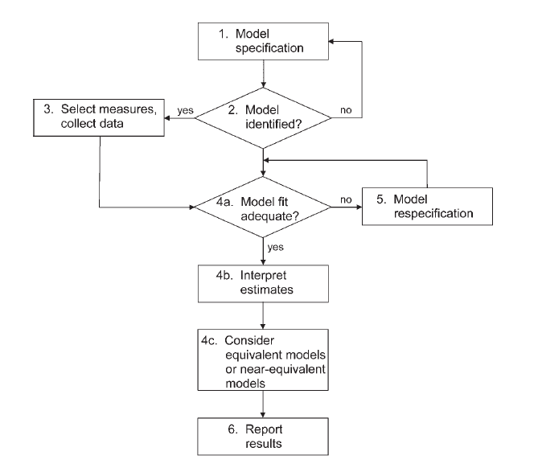

Slide 37
Specification
Specification is the term for generating the model hypothesis and drawing out how you think the variables are related.

Slide 38
Specification Errors
Omitted predictors that are important but you left them out
LOVE – left out variable error

Slide 39
Covariances
To be able to understand identification, you have to understand that SEM is an analysis of covariances
You are trying to explain as much of the variance between variables with your model

Slide 40
Covariances
You can also estimate a mean structure
Usually when you want to estimate factor means (actual numbers for those bubbles).
You can compare factor means across groups as an analysis.

Slide 41
Sample Size
The N:q rule
Number of people = N
q number of estimated parameters (will explain in a bit)
You want the N:q ratio to be 20:1 or greater in a perfect world, 10:1 if you can manage it.

Slide 42
Identification
Essentially, models that are identified have a unique answer (also invertable matrix)
That means that you have one probable answer for all the parameters you are estimating
If lots of possible answers exist (like saying X + Y = some number), then the model is not identified.

Slide 43
Identification
Identification is tied to:
Parameters to be estimated
Degrees of Freedom

Slide 44
Identification
Free parameter – will be estimated from the data
Fixed parameter – will be set to a specific value (i.e. usually 1).

Slide 45
Identification
Constrained parameter – estimated from the data with some specific rule
I.e. Setting multiple paths to some variable name (like cheese). They will be estimated but forced to all be the same
Also known as an equality constraint

Slide 46
Identification
Cross group equality constraints – mostly used in multigroup models, forces the same paths to be equal (but estimated) for each group

Slide 47
Identification
Other constraints that aren’t use very often:
Proportionality constraint
Inequality constraint
Nonlinear constraints

Slide 48
Figuring out what’s estimated
1
So each path without a one will be estimated:
4 paths (regression coefficients)
Then each error term variance (not shown) will be estimated:
6 variances
Remember the paths will not be estimated because they include a 1 on them.
Each factor variance will be estimated:
2 variances
The covariance arrow will be estimated:
1 covariance
1

Slide 49
Degrees of Freedom
Note: DF now has nothing to do with sample size.
Possible parameters
P(P+1) / 2
Where P = number of observed variables

Slide 50
Degrees of Freedom
P for our model = 6 (6+1) / 2 = 21
DF = possible parameters – estimated parameters
df = 21 – 13 = 8

Slide 51
Identification
Just identified – you have as many things to estimate as you do degrees of freedom
That means that df = 0.
EEEK.

Slide 52
Identification
Over identified – when you have more parameters you could estimate than you do
df is a positive number.
GREAT!

Slide 53
Identification
Under identified – you are estimating more parameters than possible options you have
df = negative
BAD!

Slide 54
Identification
Empirical under identification – when two observed variables are highly correlated, which effectively reduces the number of parameters you can estimate

Slide 55
Identification
Even if you have an over identified model, you can have under identified sections.

Slide 56
Identification
The reference variable is the one “you” set to 1.
That helps with the df to keep over identification, gives the variables a scale, and generally helps things run smoothly.
A cool note: the variable you set does not matter.
Except in very strange cases where that particular observed variable has no relationship with the latent variable.

Slide 57
Identification
Another note: The reference variable will not have an estimated unstandardized parameter.
But you will get a standardized parameter, so you can check if the variable is loading like what you think it should.
If you want to get a p value for that parameter, you can run the model once, then change the reference variable, and run again.

Slide 58
A side note
The section on second order factors we will cover more in depth when we get to CFA
The important part is making sure each section of the model is identified, so you’ll notice that (page 36) the variance is set to 1 on the second latent to solve that problem.

Slide 59
What to do?
If you have a complex model:
Start small – work with the measurement model components first, since they have simple identification rules
Then slowly add variables to see where the problem occurs.

Slide 60
Kline stuff
Chapter 2 = a great review of regression techniques
Chapter 3 = data screening review
(next slide is over page 50-51)
Chapter 4 = tells you about the types of programs available

Slide 61
Kline Stuff
Chapter 5 – specification, what the symbols are etc.
Chapter 6 – Identification (covered a lot of this)
Page 130 on has specific identification guidelines that are good rules of thumb

Slide 62
Positive Definite Matrices
One of the problems you’ll see running SEM is an error about “matrix not definite”.
What that indicates is the following:
1) matrix is singular
2) eigenvalues are negative
3) determinants are zero or negative
4) correlations are out of bounds

Slide 63
Positive Definite Matrices
Singular matrix
Simply put: each column has to indicate something unique
Therefore, if you have two columns that are perfectly correlated OR are linear transformations of each other, you will have a singular matrix.

Slide 64
Positive Definite Matrices
Negative eigenvalues – remember that eigenvalues are combinations of variance
And variance is positive (it’s squared in the formula!)
So negative = bad.

Slide 65
Positive Definite Matrices
Determinants = the products of eigenvalues
So, again, they cannot be negative.
A zero determinant indicates a singular matrix.

Slide 66
Positive Definite Matrices
Out of bounds – basically that means that the data has correlations over 1 or negative variances (called a Heywood case).

